Slide 1
Resistors
Physical materials do resist the flow of electrical current to some extent:
Conductors- offer low resistance to current flow.
Insulators- offer extremely high resistance to current flow.
In Electronics and Electrical circuits, materials with specific resistance values between that of a conductor and an insulator are needed. These are what we call Resistors
They can be expressed in Ohms (Ω)

Slide 2
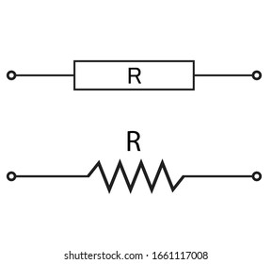
Resistors
RESISTOR SYMBOL

Slide 3
Resistors…
Resistors as the name implies, are designed to provide some desirable or necessary amount of resistance to current flow in a circuit.
They can also be used to drop voltage.
Resistors do not generate electrical energy, but merely absorb it .
This energy is dissipated in the form of heat.
The performance of a resistor is not affected by frequency (it behaves in the same way in both dc and ac circuits)

Slide 4
Resistors…
Resistors are specified by
resistance value in ohms;
tolerance as a percentage of the nominal value; and
power rating in watts.
They can also be categorized by their type of construction

Slide 5
Resistors…
There are various types of resistors;
Fixed resistors
-Carbon composition
-Carbon Film
-Metal Film
Wire wound
Variable resistors
-Potentiometers
-Rheostat
-Trimmer

Slide 6
Resistors…
Resistance value and tolerance are normally indicated by a color code consisting of four colored rings, starting at, or close to, one end.
These are read as follows:
1st ring gives first digit
2nd ring gives second digit
3rd ring gives number of zeros to put after first two digits

Slide 7
Resistors…
The fourth colored ring gives the tolerance:
Silver- 10% tolerance either side of the nominal value
Gold-5% tolerance either side of the nominal value
Red 2% tolerance either side of the nominal value
Brown-1% tolerance either side of the nominal value
Absence of a fourth ring implies a tolerance of 20 percent

Slide 8
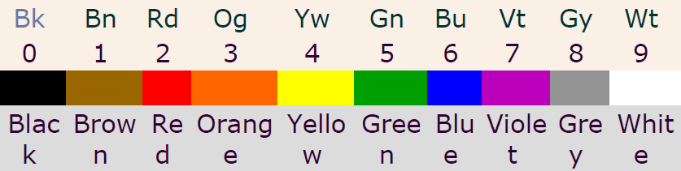
Resistors…
COLOR CODE

Slide 9
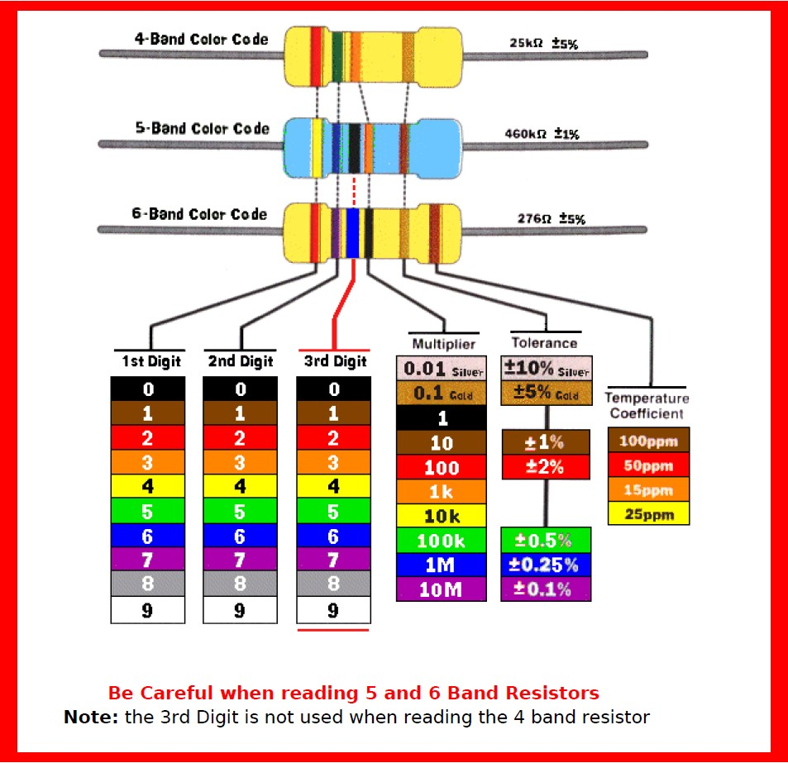

Slide 10
Resistors…
Tolerance- denotes the acceptable deviation in the resistance value of a resistor.
For example: the marked resistance 1kΩ with a 10% tolerance can have any value between 900Ω-1100Ω
This is mainly because in manufacturing thousands of resistors are made and its not possible to adjust all of them to the exact value.
The normal specified tolerances are 5%, 10% and 20% for ordinary resistors and 0.1% for precision resistors.

Slide 11
Resistors…
Voltage rating
Maximum operating voltage also can be specified for resistors but since this is usually of the order of 250Volts or more
This parameter is not important when choosing resistors for battery circuits. Resistors used on main circuits must, however have a suitable voltage rating.

Slide 12
Resistors Questions
Find the value of resistance of the following resistors
(i) Brown-Black-Red-Gold
(ii) Brown-Green-Red-Violet
(iii) Brown-Green-Red-Blue- Violet
(iv) Green-Brown-Violet-Black-Gold-Orange

Slide 13
OHMETER
The instrument, which is used to measure the value of resistance between any two points in an electric circuit is called ohmmeter.
It can also be used to find the value of an unknown resistor.
The units of resistance are ohm and the measuring instrument is meter.
So, the word “ohmmeter” is obtained by combining the words “ohm” and “meter”.
Types of Ohmmeters
(i) Series Ohmmeter
(ii) Shunt Ohmmeter

Slide 14
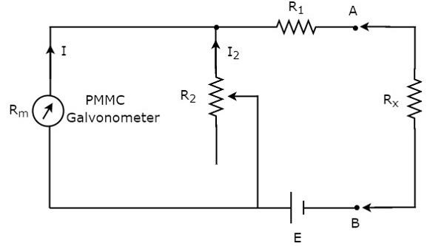
OHMETER…
(i) Series Ohmmeter
If the resistor’s value is unknown and has to be measured by placing it in series with the ohmmeter, then that ohmmeter is called series ohmmeter.
The circuit diagram of series ohmmeter is shown in below figure.

Slide 15
OHMETER…
The part of the circuit, which is left side of the terminals A & B is series ohmmeter.
So, we can measure the value of unknown resistance, Rx by placing it to the right side of terminals A & B.
Series ohmmeter is useful for measuring high values of resistances.

Slide 16
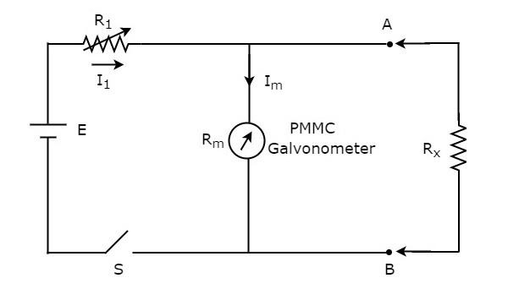
OHMETER…
(ii)Shunt Ohmmeter
If the resistor’s value is unknown and to be measured by placing it in parallel (shunt) with the ohmmeter, then that ohmmeter is called shunt ohmmeter.
The circuit diagram of shunt ohmmeter is shown in below figure.

Slide 17
OHMETER…
The part of the circuit, which is left side of the terminals A & B is shunt ohmmeter.
So, we can measure the value of unknown resistance by placing it to the right side of terminals A & B.
Shunt ohmmeter is useful for measuring low values of resistances.
We can use either series ohmmeter or shunt ohmmeter based on the values of resistances that are to be measured i.e., high or low.

